Slide 1
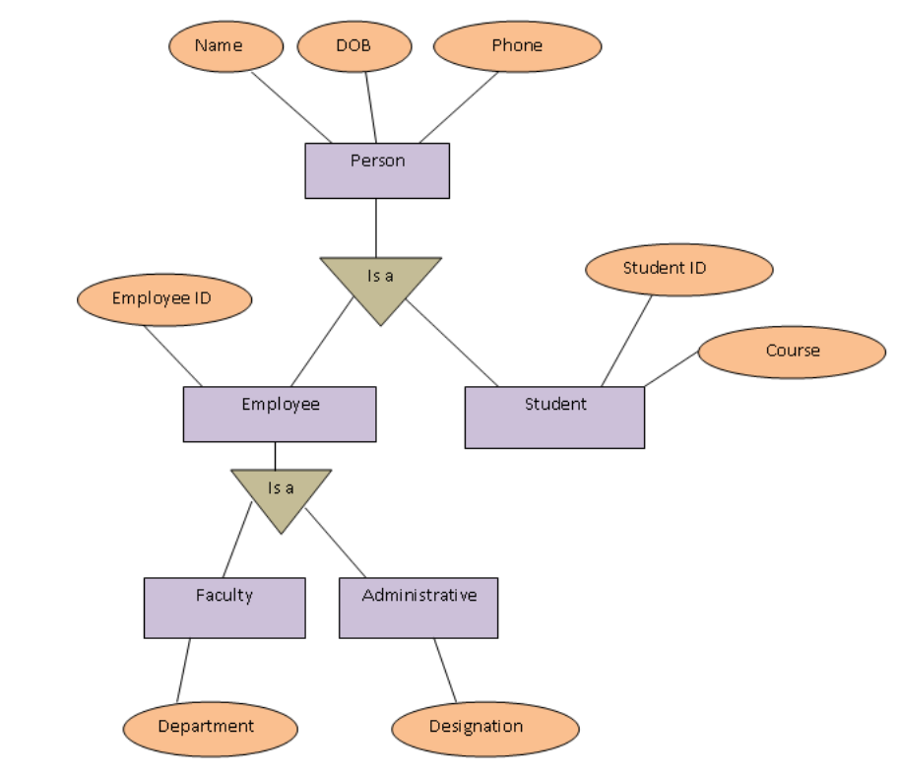
specialization
In the above example person is an entity type with three attributes name, age, phone. A person in an educational institute can be employee or student. Employee entity has an additional attribute employee ID. Student entity has two additional attributes student ID and course. Employee entity type is further specialized in two entities faculty and administrative. Faculty entity type has attribute department and administrative entity has attribute designation.

Slide 2
specialization
While converting an ER diagram into tables we write respective schemas. But schemas against all entities are not formed. Schemas are formed against only leaf entities. We do not write schema for person entity because person is an employee or a student. Further employee is a faculty or administrative. So, we make schemas of only student, faculty and administrative entity types.
Schemas:
Student (Name, Age, Phone, Student ID)
Faculty (Name, Age, Phone, Employee ID, Department)
Administrative (Name, Age, Phone, Employee ID, Designation)
Here, student schema inherits attributes of person. Faculty and administrative entities inherit the attributes of person and employee.

Slide 3
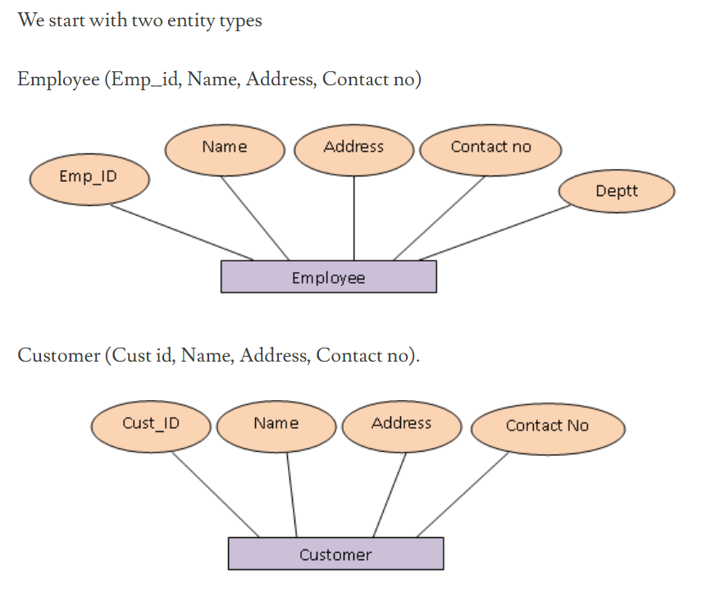
Generalization
Generalization is the reverse of specialization. In this process differences among multiple entity types are suppressed. Their common features are identified and then generalized into single super class of which the original entity types are special subclasses.

Slide 4
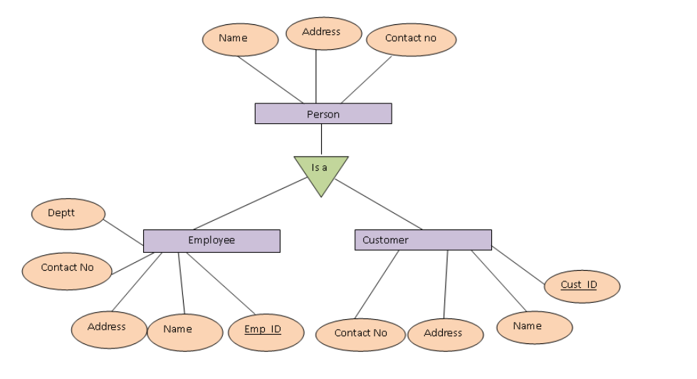
Generalization
These two are special entities types. We can merge these two entities into one entity type named person. We have made these two special entities general. In this process common attributes are included in the general entity.

Slide 5
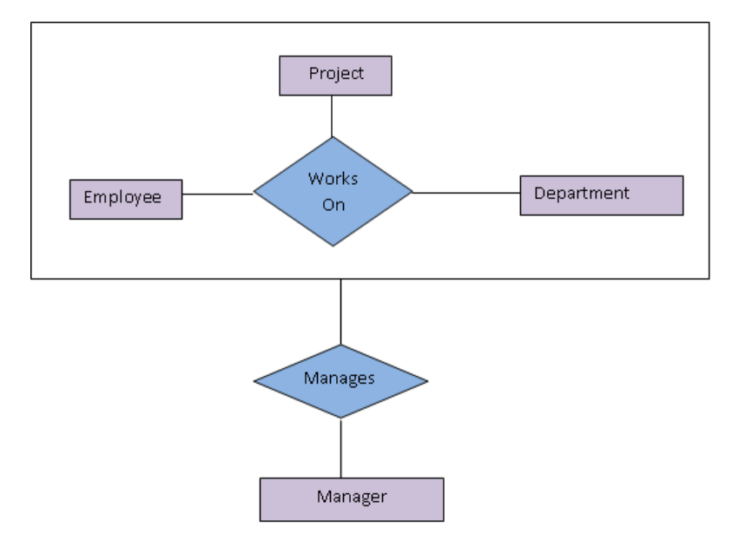
aggregation
Suppose in an organization the manager entity manages set of employee in a department working on specific projects.
Employee, department and projects are entity types having a ternary relationship called works on. Manager manages employee, manager also manages department and manager also manages projects. It is difficult to represent this complicated relationship representation in ER diagram. It will be quite complicated to involve entity types into a relationship when they already are participating in a relationship.
Aggregation is used to solve such complication representations. In aggregation we represent same employee, department and project entities and their relationship as a higher level entity by aggregating. Here we have another entity manager who creates a relationship with this higher level entity.

Slide 6
Conversion of e-r model to relational model

Slide 7
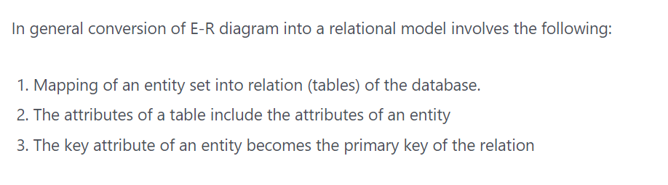
Steps

Slide 8
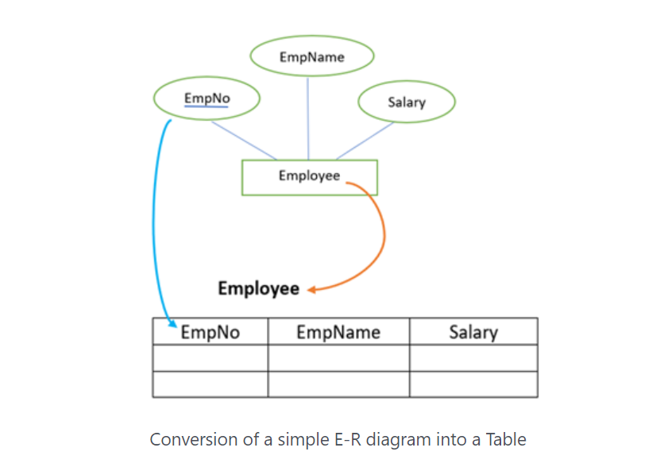
Example conversion

Slide 9
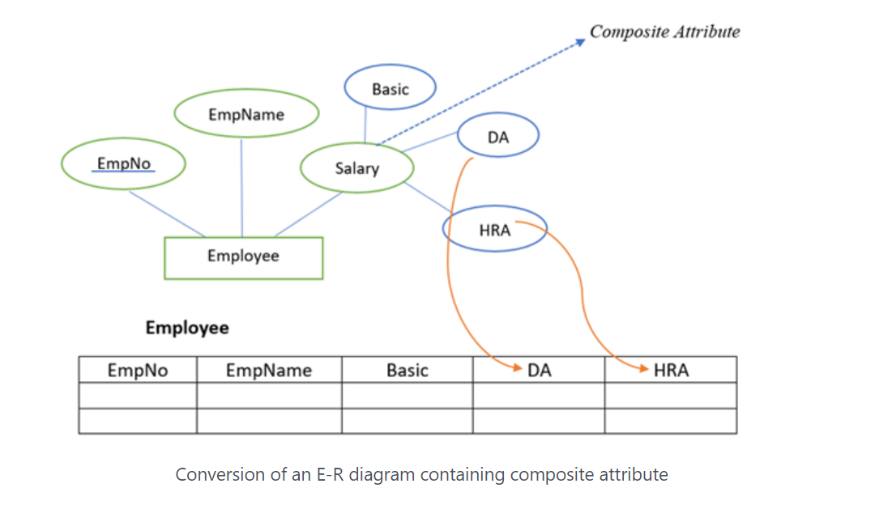
Entity set with a composite attribute

Slide 10
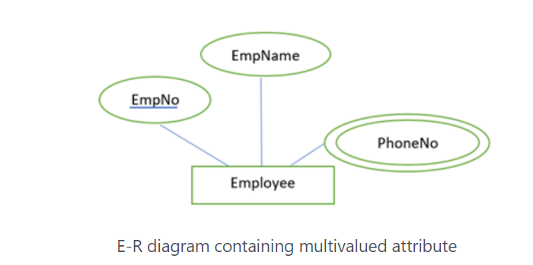
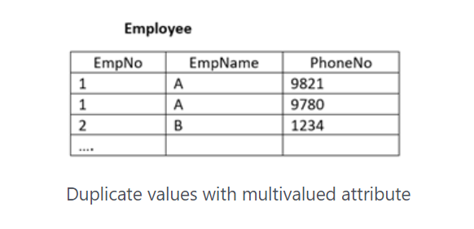
Entity set with multi valued attribute

Slide 11
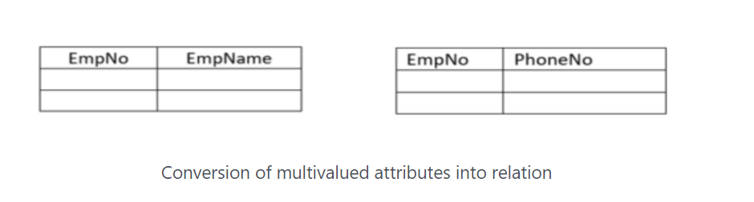
Conversion of multi valued attributes into a relation

Slide 12
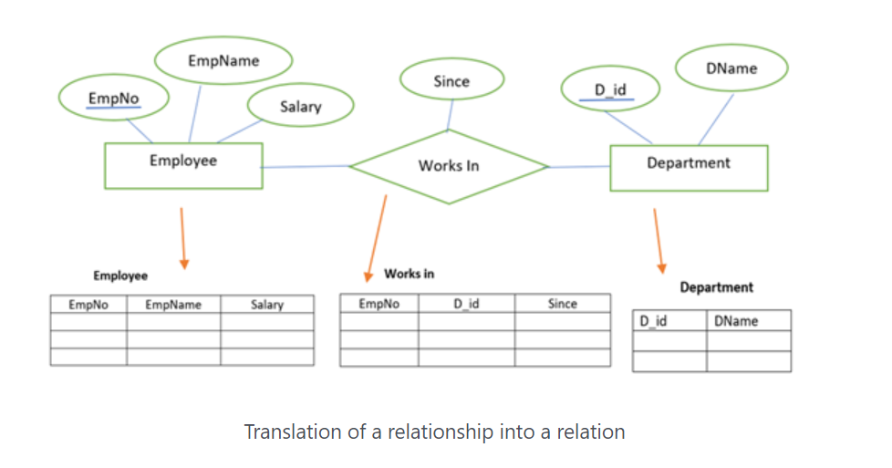
Translation of relationship into a relation

Slide 13
End of first unit.

